Slide 1
Multimedia Systems Lecture – 23
By
Dr. Priyambada Subudhi
Assistant Professor
IIIT Sri City

Slide 2
Huffman Coding
First presented by Huffman in a 1952.
This method attracted an overwhelming amount of research and has been adopted in many important and/or commercial applications, such as fax machines, JPEG, and MPEG.
In contradistinction to Shannon–Fano, which is top-down, the encoding steps of the Huffman algorithm is a bottom-up approach.
Let us use the same example word, HELLO. A similar binary coding tree will be used as above, in which the left branches are coded 0 and right branches 1. A simple list data structure is also used.

Slide 3
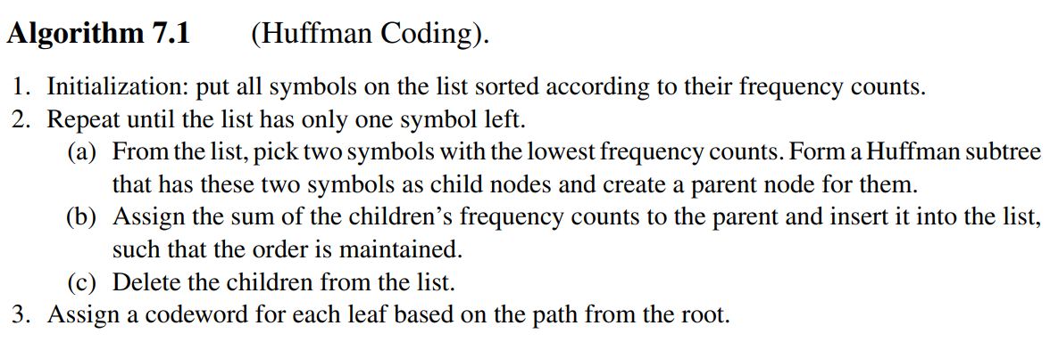
Huffman Coding Algorithm

Slide 4
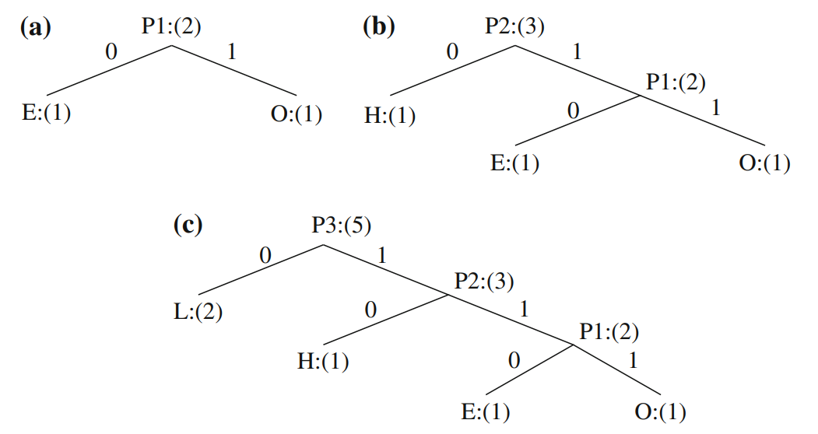











Coding tree for HELLO using the Huffman algorithm. a First iteration; b Second iteration; c Third iteration

Slide 5
symbols P1, P2, P3 are created to refer to the parent nodes in the Huffman coding tree.
The contents in the list are illustrated below:
After initialization: L H E O
After iteration (a): L P1 H
After iteration (b): L P2
After iteration (c): P3
The average number of bits used to code each character is also 2, (i.e., (1 + 1 + 2 + 3 + 3)/5 = 2).
Example-2: Consider a text string containing a set of characters and their frequency counts as follows: A:(15), B:(7), C:(6), D:(6) and E:(5). Find out the number of bits required in case of Shanon-Fano and Huffman Coding.

Slide 6


















